Slide 1

SYBCA – SEM-4
Introduction of XML
Web Designing - 2

Slide 2
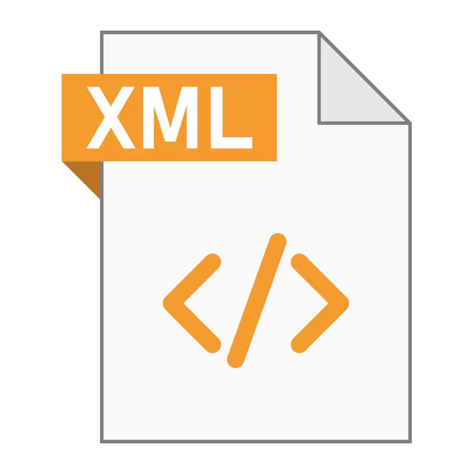
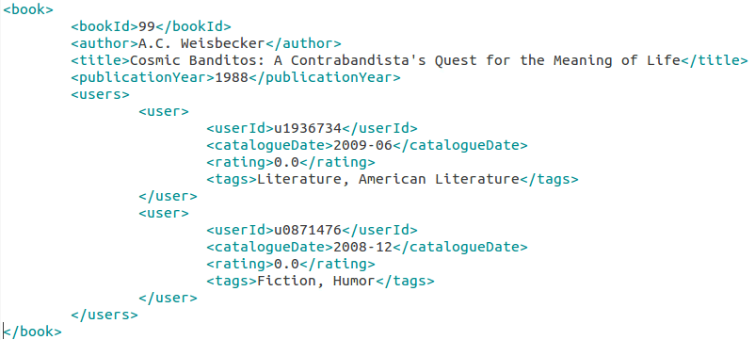
INTRODUCTION TO XML
Key Concepts, Syntax, and Examples

Slide 3

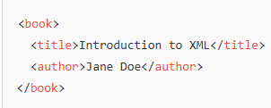

WHAT IS XML?
eXtensible Markup Language
Defination:
A markup language for storing and transporting data.
Characteristics
Use Cases:
Self-descriptive and human-readable.
Supports nested elements and hierarchical data.
Platform and language-independent.
Data sharing between systems.
Configuration files.
Web services (e.g., SOAP, RSS feeds).

Slide 4
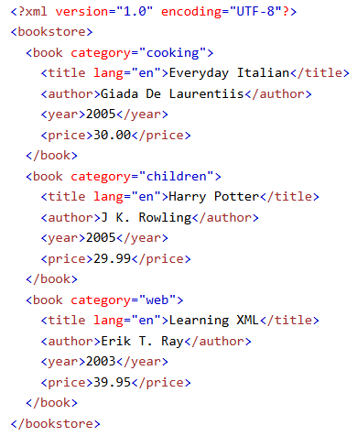
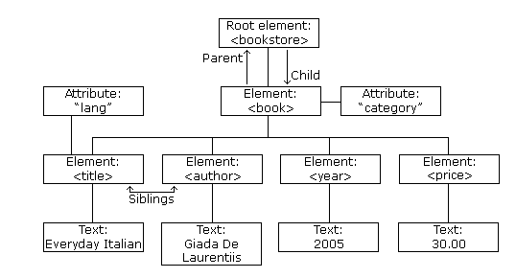
XML Tree
eXtensible Markup Language

Slide 5
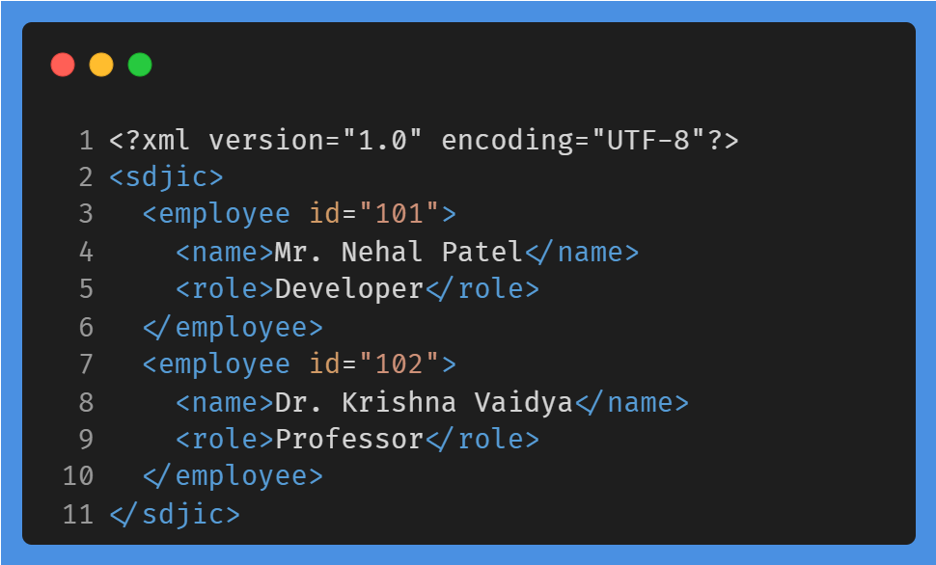
XML SYNTAX
eXtensible Markup Language
XML Declaration: Specifies the version and encoding.
<?xml version="1.0" encoding="UTF-8"?>
Tags: Define data and are case-sensitive. <name>Nehal Patel</name>
<Name>Nehal Patel</Name>
Elements: Contain opening and closing tags. <name>Nehal Patel</name>
Attributes: Store additional information about an element.
<employee id="101">

Slide 6
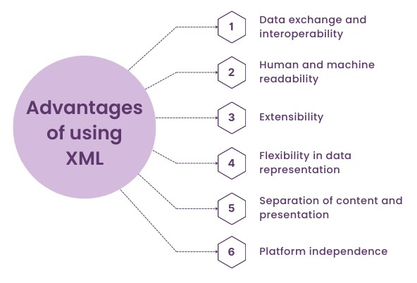
XML Features
eXtensible Markup Language
Features and Advantages of XML
XML separates data from HTML
XML simplifies data sharing
XML simplifies data transport
XML simplifies Platform change
XML increases data availability
XML can be used to create new internet languages
XHTML, WSDL, WAP, WML, RSS, RDF, OWL, SMIL

Slide 7
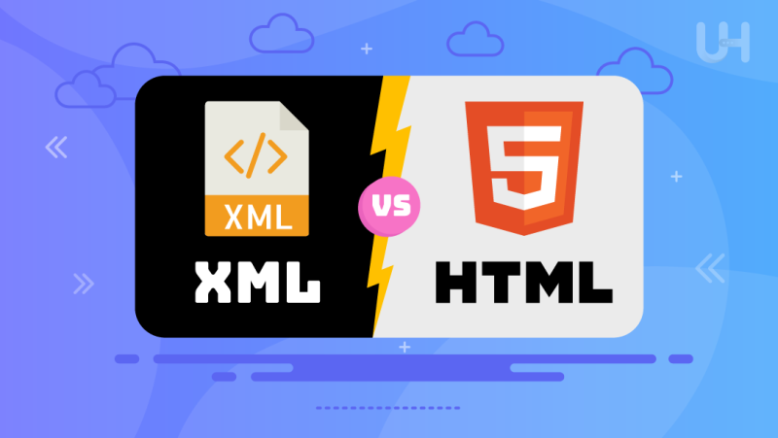
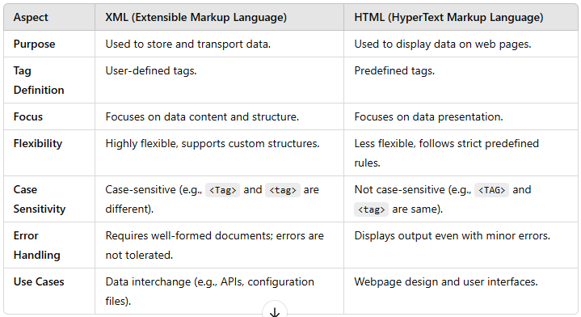
XML vs HTML

Slide 8

XML Rules
XML Rules
XML Documents Must Have a Root Element
The XML Prolog
All XML Elements Must Have a Closing Tag
XML Tags are Case Sensitive
XML Elements Must be Properly Nested
XML Attribute Values Must Always be Quoted
Entity References
Comments in XML
White-space is Preserved in XML
XML Stores New Line as LF
Well Formed XML

Slide 9

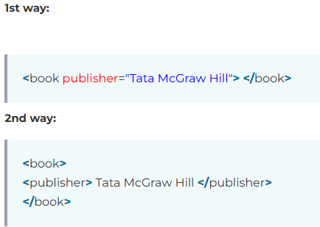
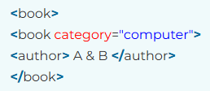
XML
eXtensible Markup Language
XML Attributes
XML attributes must always be quoted. We can use single or double quote.
Metadata should be stored as attribute and data should be stored as element.

Slide 10
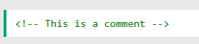
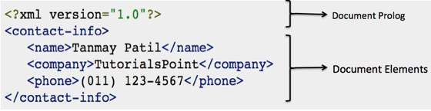
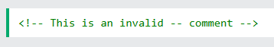
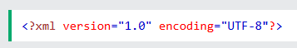
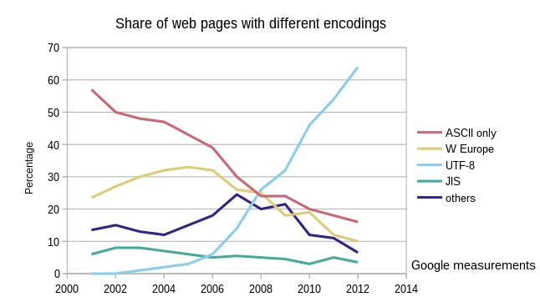
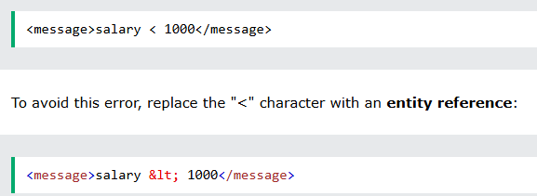
XML Comments
XML Prolog
Invalid XML Comments

